Slide 1




Case Presentation
Case Analysis

Slide 2
Guru Mantra
I keep six honest serving men (They taught me all I knew); their names are: What and Why and When; And How and Where and Who.
— Rudyard Kipling

Slide 3

What is a CASE?

Slide 4
What is a Case?
Narrative of an actual or realistic situation or problem (in written or filmed form), which needs a decision.
It is an exercise in building analytical bridges between theory and actual or simulated “real life” situation.

Slide 5
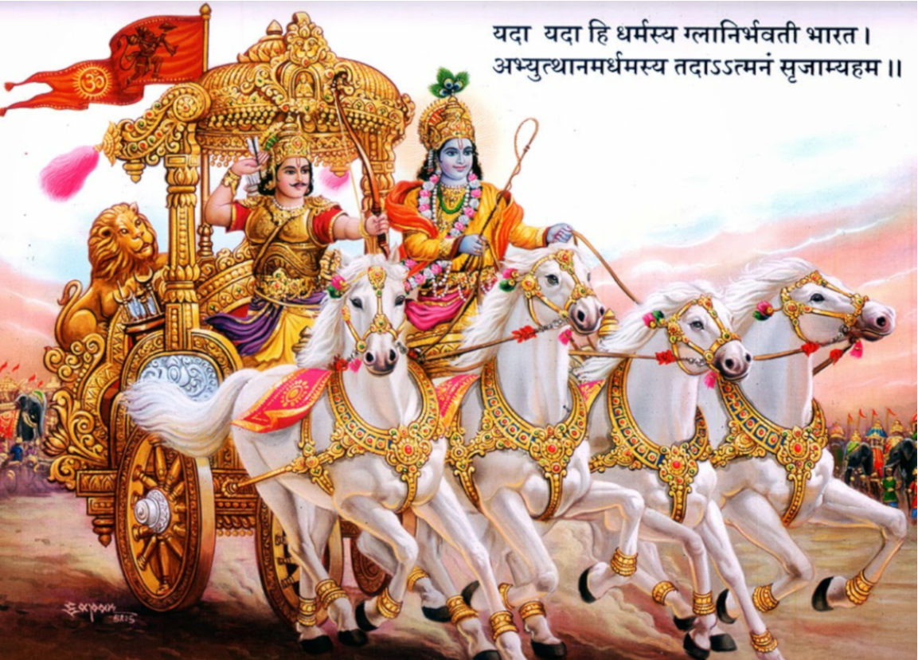
In
EPIC
MAHABHARAT

Slide 6
Who is Better?
Pandavas
Kauravas

Slide 7
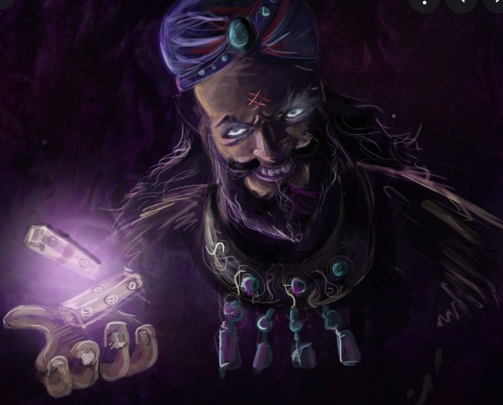
Shakuni

Slide 8
Shakuni also known as Saubala and Subalraja was the prince of the Gandhara Kingdom, later to become the King after his father's death. He is the main antagonist in the Hindu epic Mahabharata. He was the brother of Gandhari and hence Duryodhana's maternal uncle.
Portrayed as an extremely intelligent, crafty and devious man, Shakuni is often credited as the mastermind behind the Kurukshetra War. He influenced his nephews, especially Duryodhana, from their childhood and plotted against the Pandavas multiple times. Later in the epic, Shakuni planned the game of dice, which was one of the turning points. During the war, Shakuni was killed by the Pandava Sahadeva.

Slide 9
Is Shakuni a good man?
Yes
No

Slide 10
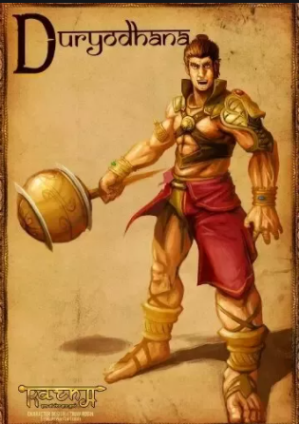

Slide 11
Duryodhana also known as Suyodhana, is the main antagonist in the Hindu epic Mahabharata and was the eldest of the Kauravas, the hundred sons of a blind king Dhritarashtra and queen Gandhari. Being the firstborn son of the blind king, he was the crown prince of Kuru Kingdom and its capital Hastinapura along with his cousin Yudhishtra who was older than him. Although loved by his family, Duryodhana and most of his brothers were not seen on the same level as the Pandavas in their adherence to virtue, duty, and respect for elders. Duryodhana felt that the partiality everyone showed to the Pandavas was only due to the circumstances of their birth. Duryodhana was mentored by his maternal uncle Shakuni, who masterminded most of Duryodhana's plots to humiliate and kill the Pandavas.

Slide 12
Is Duryodhana a good human?
Yes
No

Slide 13
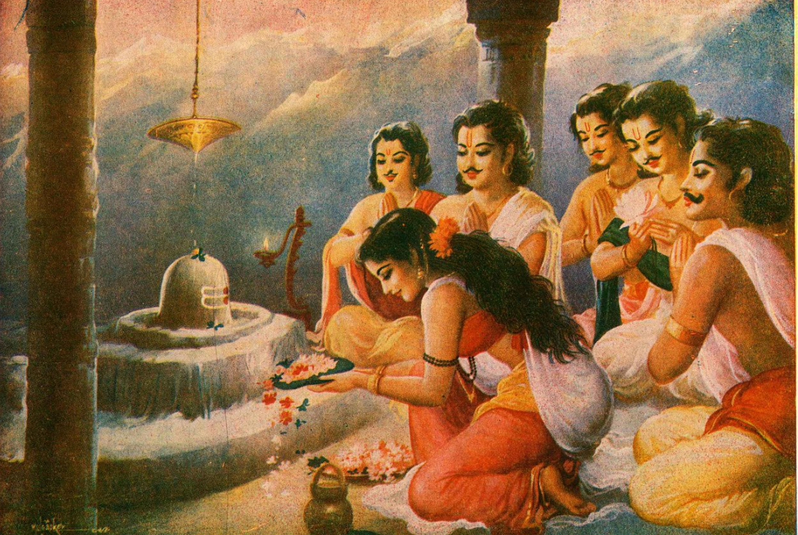
Pandavas

Slide 14
The Pandavas refers to the five brothers namely, Yudhishthira, Bhima, Arjuna, Nakula and Sahadeva, who are the main characters in the epic Mahabharata. They were the acknowledged sons of Pandu, the king of Hastinapur and his two wives Kunti and Madri. The Pandavas waged war against their cousins Kauravas (Duryodhana and his brothers); this was known as Kurukshetra War. The Pandavas won the war and the Kauravas lost. The Pandavas were celebrated for their adherence to virtue, duty, and respect for elders.

Slide 15
Are Pandavas good humans?
Yes
No

Slide 16
Case - Characteristics
Information supplied in the case is frequently partial and, at times, even misleading or biased
Alternatively, the sheer volume of information given is overwhelming
To further complicate matters, the problems presented are both ambiguous and complex (and so are real life situations too)
Generally, a case has no single “correct” answer. There are only choices, and the reasons behind them – some better and some worse than the others

Slide 17
Case - Characteristics
Requires working together in a group to analyze and solve a problem
Unlike lectures, case discussion demands your ideas and active participation (from passive listener to active contributor)
One cannot learn driving by listening to a lecture about it. Likewise, analyzing and decision making have to be learnt through practice

Slide 18
Case - Objectives
Increase your understanding of what managers should and should not do in guiding a business to success.
Get valuable practice in identifying specific business or managerial issues that need to be addressed, evaluating alternatives, and formulating workable plans of action
Enhance your sense of business judgment, as opposed to uncritically accepting what the professor says or the “back-of-the-book” answers.
Group discussions afford multiple context and perspective opportunities

Slide 19
ANALYSIS
MAHABHARAT

Slide 20
Who is a better human being?
Pandavas
Kauravas

Slide 21
Shakuni also known as Saubala and Subalraja was the prince of the Gandhara Kingdom, later to become the King after his father's death. He is the main antagonist in the Hindu epic Mahabharata. He was the brother of Gandhari and hence Duryodhana's maternal uncle.
Portrayed as an extremely intelligent, crafty and devious man, Shakuni is often credited as the mastermind behind the Kurukshetra War. He influenced his nephews, especially Duryodhana, from their childhood and plotted against the Pandavas multiple times. Later in the epic, Shakuni planned the game of dice, which was one of the turning points. During the war, Shakuni was killed by the Pandava Sahadeva.

Slide 22
Is Shakuni’s actions justified?
Is Shakuni essentially a good or a bad man?
Yes
No
A Good man
A Bad man

Slide 23
Duryodhana also known as Suyodhana, is the main antagonist in the Hindu epic Mahabharata and was the eldest of the Kauravas, the hundred sons of a blind king Dhritarashtra and queen Gandhari. Being the firstborn son of the blind king, he was the crown prince of Kuru Kingdom and its capital Hastinapura along with his cousin Yudhishtra who was older than him. Although loved by his family, Duryodhana and most of his brothers were not seen on the same level as the Pandavas in their adherence to virtue, duty, and respect for elders. Duryodhana felt that the partiality everyone showed to the Pandavas was only due to the circumstances of their birth. Duryodhana was mentored by his maternal uncle Shakuni, who masterminded most of Duryodhana's plots to humiliate and kill the Pandavas.

Slide 24
Is Duryodhana’s actions justified?
Is Duryodhana essentially a good or a bad man?
Yes
No
A Good man
A Bad man

Slide 25
The Pandavas refers to the five brothers namely, Yudhishthira, Bhima, Arjuna, Nakula and Sahadeva, who are the main characters in the epic Mahabharata. They were the acknowledged sons of Pandu, the king of Hastinapur and his two wives Kunti and Madri. The Pandavas waged war against their cousins Kauravas (Duryodhana and his brothers); this was known as Kurukshetra War. The Pandavas won the war and the Kauravas lost. The Pandavas were celebrated for their adherence to virtue, duty, and respect for elders.

Slide 26
Are Pandava’s actions justified?
Are Pandava essentially a good humans?
Yes
No
Yes
No

Slide 27
Case Analysis

Slide 28
Case Analysis is a systematic, well organized and well structured document which defines and analyses a subject or problem.

Slide 29
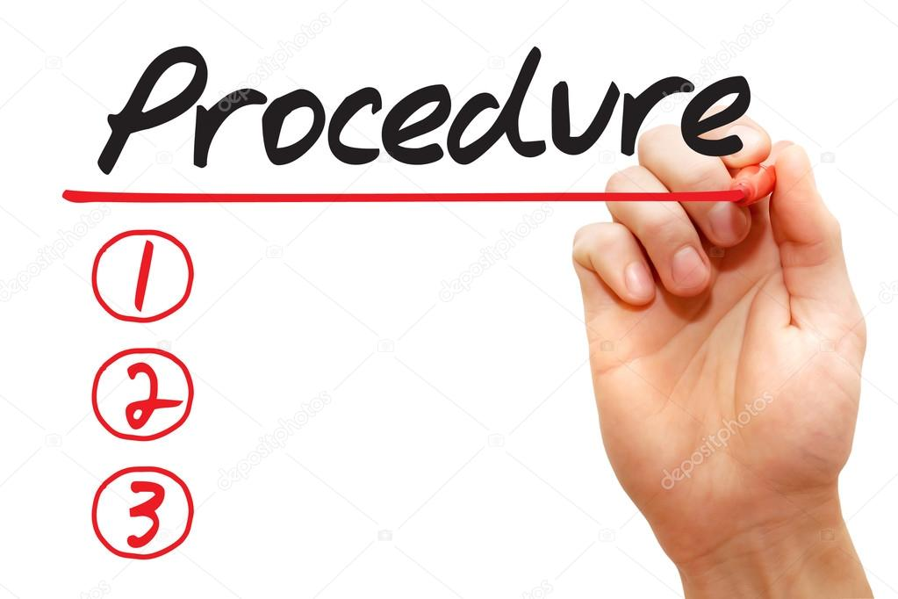
Case Presentation
Case Review

Slide 30
Step #1 : Gaining Familiarity
Read the case couple of times.
First read it top to bottom and try to grasp the case.
Second read section wise trying to get the idea given in each section.
If data are given read the data carefully and make your own deductions.
Determine who, what, when, where, how & why

Slide 31
Step #2 : Structure
Synopsis
Identification of core issues / problems
Supporting facts related to core issues
Analysis of each core issue/s
Solutions
Managerial implication/s with Limitations of MI

Slide 32

Step #2 : Structure
- SYNOPSIS
A brief summary of range, contents and argument of the article.
This section should not normally take up more than 1-2 Complex Sentences.
One sentence preferred.

Slide 33

What is the SYNOPSIS of Mahabharata?

Slide 34
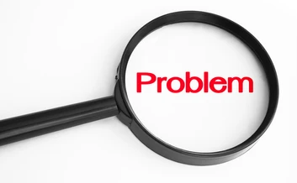
Step #2 : Structure
- IDENTIFICATION OF CORE ISSUES
List core issues/problems
Ensure that symptoms are not assumed to be the problems
Normally they end with a question mark

Slide 35
What is/are the CORE ISSUE/IES of Mahabharata?

Slide 36

Step #2 : Structure
- FACTS OF CORE ISSUES
Identify the fact/s or evidences that support each core issue/s from the case
Limit yourself to what the case says

Slide 37

Step #2 : Structure
- ANALYSIS
Decide which models/ideas/theories seem useful
Apply these conceptual tools to the situation
Pros and Cons of the ideas stated in the case
Identify inconsistencies or gaps

Slide 38

Step #2 : Structure
- ANALYSIS - Economic Tools
Illustrate your analysis with diagrams, data, proper headings and subheadings etc.
Refer to thoughts of different writers

Slide 39
Step #2 : Structure
- ANALYSIS - Economic Tools
- PESTEL Analysis
- SWOT Analysis
Tools to help you think and analyze

Slide 40
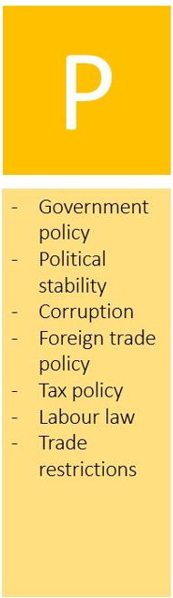






Slide 41
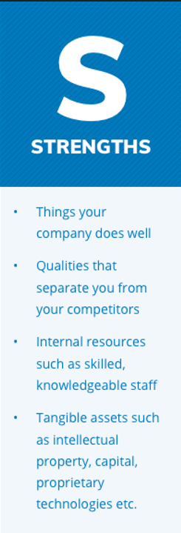
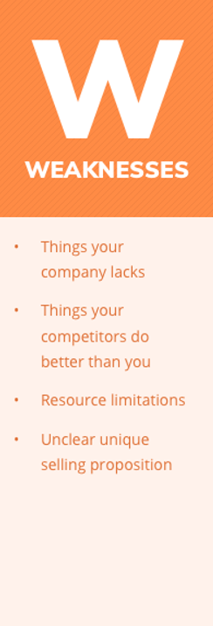





Slide 42
Can you relate Shakuni's behavior with any of Micro Economic theories? Why?

Slide 43
How can you relate the incident when Kunti asked her sons to share Draupadi among themselves with any Economic theories?

Slide 44

Step #2 : Solutions
Any possible solutions or recommendations to the stated problem in the case.
Limitations to the solutions provided if any.

Slide 45
What are the solutions for all the issues that you have identified in Mahabharata?

Slide 46

Step #2 : Managerial Implications
How has it improved your understanding or knowledge?
How does the work fit in real business world and why?

Slide 47
As a student of management, what have you learnt from Mahabharata?

Slide 48

Step #3 : References
Set out the list of books, websites, articles (in APA format) that you have referred to while preparing the presentation

Slide 49
Some TIPs
Be structured.
Always think of Pros and Cons for the Ideas provided in the case.
Use theories to analyze but do not give much importance to only one
There is no one right answer to the problem posed in the case but there are better and worse ways to present ideas.

Slide 50
LASTLY
Continually ask “WHAT” “WHY” “WHEN” “HOW” “WHERE” “WHO”
Always express it in such a way that even a child can understand - keep it simple
Look for the explanation in the case minutely so the implication is obvious.
Case Review - JOB DIVISION should be mentioned

Slide 51
For Case Presentations
The presenter group is to conduct an analytical case presentation of not exceeding 30 minutes
Follow the format provided.
The grading will be based on the presentation (50%)
and question answer session participation (50%)
For each presentation - NO prior job division.
Job Division for the presentation- who is going to present which part - will be provided in the class on the day of presentation with 10 minutes preparation time.
Audience members need to ask as many questions and counter questions during the discussion session.

Slide 52
For Case Reviews
The audience students is to conduct an analytical case review.
Follow the format provided.
Needs to be submitted prior the case presentation in class (Hard Copy)- will be pre informed.
The grading will be based on the analysis, how well you justify your points and on format.

Slide 53
What makes your Case Analysis a GOOD one?
A Good Focused Research on the given case
Good Knowledge of Economics supporting your logic
Evidence based logic supported by data
Following the prescribed structure of Case Analysis

Slide 54
Let’s explore our Limits and Possibilities
Thanks!
Any questions?

